Slide 1

CS 533 INTRO TO DATA SCIENCE
Michael Ekstrand

Slide 2
PREDICTION AND INFERENCE

Slide 3

Learning Outcomes
Distinguish between prediction and inference
Understand different meanings of the word ‘inference’
Photo by Mark Boss on Unsplash

Slide 4

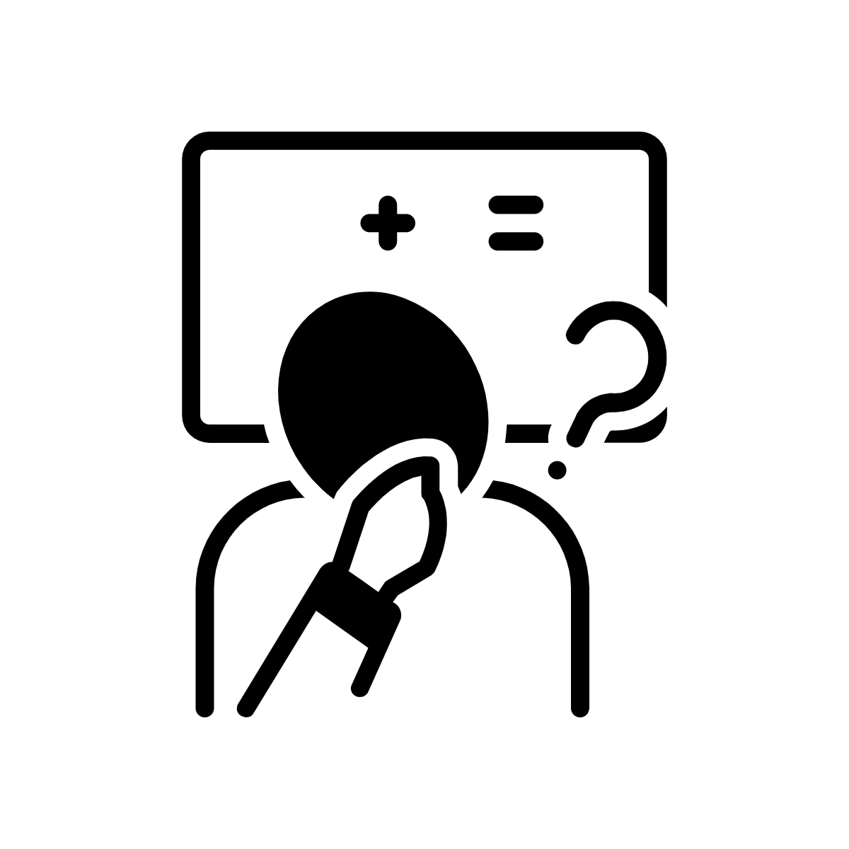
Prediction and Inference
Prediction tries to predict the future with the model.
Model does not need to be valid
Quality & strength: accuracy of predicting unseen data
Evaluation does need to be valid
Inference uses the model’s structure and parameters to learn.
Validity depends on assumptions
Quality & strength: R², p-value, assumption checks, coefficients

Slide 5
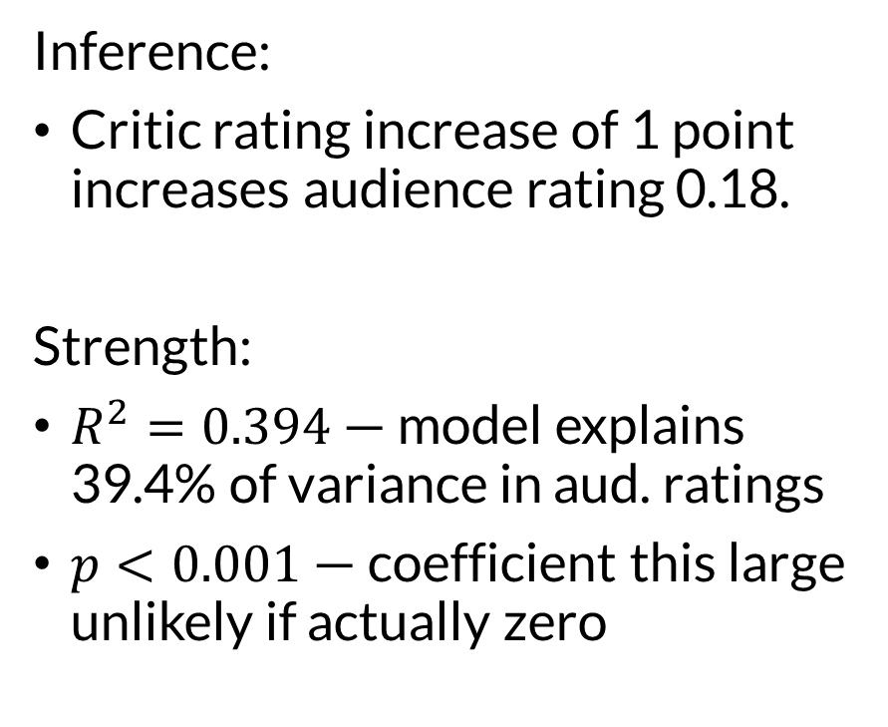
Inference
Inference:
Critic rating increase of 1 point increases audience rating 0.18.
Strength:
$R^{2}=0.394$ — model explains 39.4% of variance in aud. ratings
$p<0.001$ — coefficient this large unlikely if actually zero
Assumptions:
Linearity — that this is actually a linear relationship
Independent observations
Normal residuals
Homoskedastic residuals (equal variance)

Slide 6
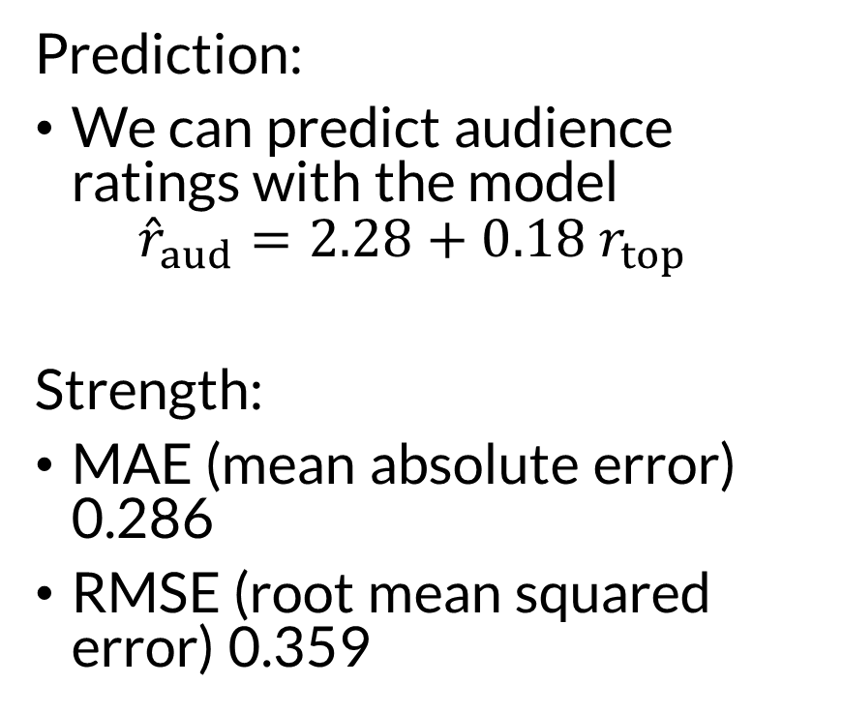
Prediction
Prediction:
We can predict audience ratings with the model ${\hat{r}}_{aud}=2.28+0.18 r_{top}$
Strength:
MAE (mean absolute error) 0.286
RMSE (root mean squared error) 0.359
Fitting assumptions: none
Testing assumptions: test data excluded from training

Slide 7
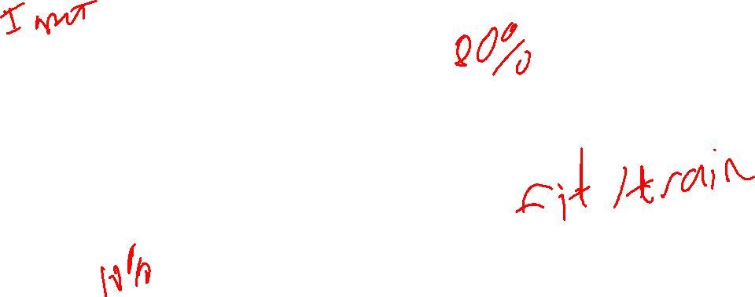
Train-Test
Data
Split
Train
Test
Model
Predict
Split before exploratory analysis of features.
Supervised learning – we have thing to predict

Slide 8
Splitting Data
Split before exploratory analysis
If testing multiple versions: split in 3
Train – train the model
Tune – optimize model, compare modeling decisions
Test – final validation, compare with current / previous system

Slide 9
Other Uses of Inference
Here: using analysis to understand (“infer”) things about the underlying world
Sometimes elsewhere: using a trained model to make predictions about specific instance (the “inference” stage of a machine learning pipeline)

Slide 10

Wrapping Up
Inference uses a model’s structure and parameters to understand an underlying phenomenon.
Prediction uses a model to predict future observations.
Inference has stronger requirements.
Photo by NeONBRAND on Unsplash

